Slide 1
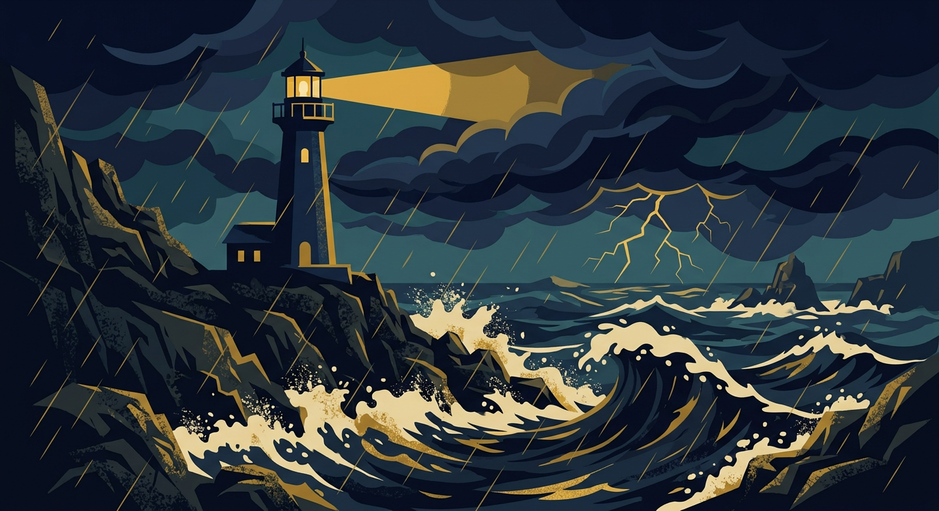
WEEK 6 READING — SLIDE 3 OF 9
Key Themes in Chapter 4
The protagonist's isolation deepens after the storm
Recurring motif: light vs. darkness as a stand-in for hope
Discussion question: what does the lighthouse symbolize here?
Comment below with your own reading of this chapter

Slide 2
WEEK 6 READING — SLIDE 4 OF 9
Character Development
Compare the protagonist at the start vs. end of the chapter
What choice marks the turning point for them?
How does the supporting cast react to that choice?

Slide 3
WEEK 6 READING — SLIDE 5 OF 9
Discussion Questions for Next Class
Bring one quote that changed how you saw the protagonist
Was the ending of this chapter earned, or did it feel rushed?
We'll vote on the two best questions to discuss as a class

Slide 4
WEEK 6 READING — SLIDE 6 OF 9
Setting and Symbolism
The storm mirrors the protagonist's internal conflict
Notice how the setting shifts from open coastline to a closed room
What other objects in this chapter feel symbolic?

Slide 5
WEEK 6 READING — SLIDE 7 OF 9
Vocabulary from This Chapter
"Tempestuous" — used to describe both the storm and the protagonist's mood
"Solitude" vs. "loneliness" — the author uses both deliberately
Look up any other word that stood out to you

Slide 6
WEEK 6 READING — SLIDE 8 OF 9
Looking Ahead to Chapter 5
Read Chapter 5 before next class
Pay attention to who the protagonist finally opens up to
Come with one prediction for how the story resolves

